Slide 1

Full Scale Analysis of a
Large-scale Botnet Attack on Twitter
Christopher Besel Juan Echeverria Shi Zhou
Prof. Chin-Tser Huang
Presented By Computer Science and Engineering
Avineet Kumar Singh University of South Carolina

Slide 2
Content
Definitions/Important terms
Issues
Objective/Research Purpose
Related Work
Bursty Botnet Dataset
URLs posted and its Analysis
Spam Attack by Bursty Botnet
State-of-the-Art Bot Classifiers
Conclusion

Slide 3
Definitions/Important terms
Social Bots (Software Robots)
URL Shortening
Phishing Websites
Spamming
Open Redirect Feature
URL Blacklisting

Slide 4
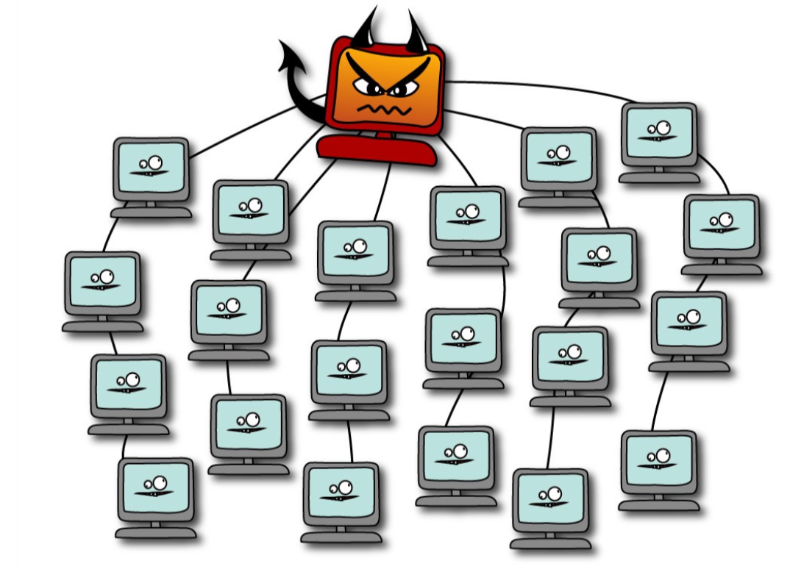

Slide 5



Slide 6
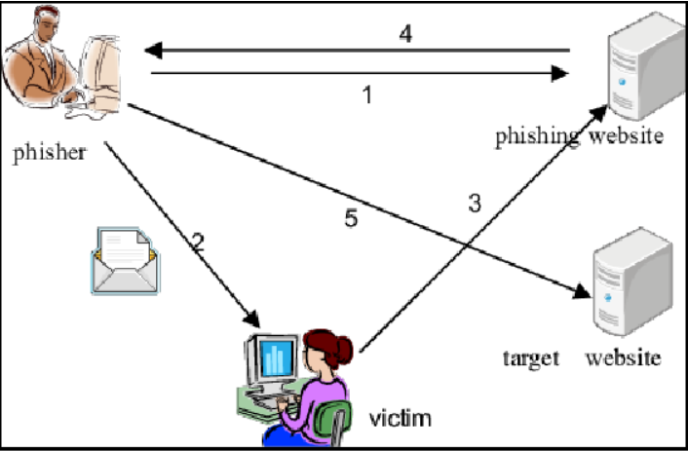

Slide 7
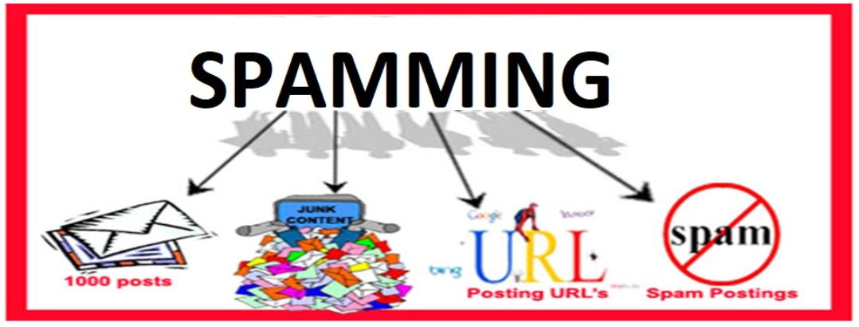

Slide 8
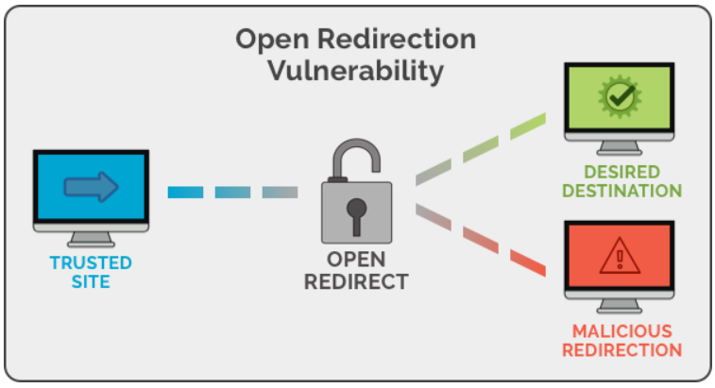

Slide 9
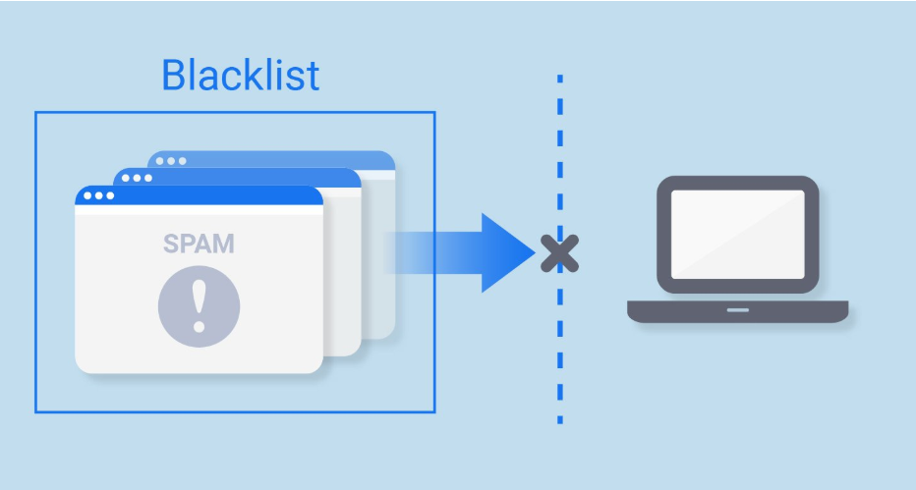

Slide 10
Issue
Social Bots might be helpful but many are designed to inflict harm in following ways:
Spread malicious content.
Manipulate digital influence.
Polluting the twitter streaming API
Launching misinformation campaigns.

Slide 11
Objective/Research Purpose
Research into purpose of these Social Bots is essential.
Purpose of this paper
In-depth analysis of the spam attack launched by one of the largest twitter botnets.
Analyzed over 500,000 twitter accounts.
Analysis of the objective, campaigns created, performance strategy and the botmaster of those accounts.

Slide 12
Related Work
Botnet Detection Approaches
Social network
Crowdsourcing
Machine learning
Hybrid

Slide 13
Related Work
Current Botnet Analysis
Small number of studies on actual analysis of botnets.
Using very small number of data sets.
Studying general bot classifiers.

Slide 14
Related Work
Strategies of Twitter Spammers
User timeline
Direct messages
Hash tags
Re-tweets and Mentions

Slide 15
Related Work
Spam Account Features
Short lived accounts - flood many tweets.
Long lived accounts - low daily tweet count.
Active immediately after registration.
very few or zero followers.

Slide 16
Related Work
Underground Infrastructure requirements
access to diverse pool of IP addresses.
email credentials to verify accounts.
CAPTCHA solving services.
large number of unique URLs.

Slide 17
Bursty Botnet Dataset
Properties(reported by Echeverria and Zhou)
more than half a million bots
User IDs between 5×10^8 and 5.35×10^8.
only tweet in the ﬁrst hour of registration.
only tweet from the source ‘Mobile Web’.
mostly tweet a URL or/and a mention users.

Slide 18
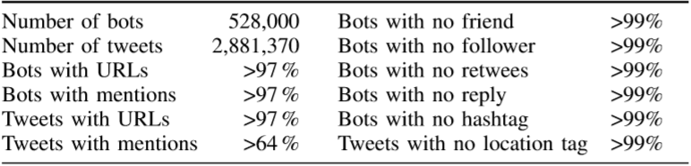
Bursty Botnet Dataset

Slide 19
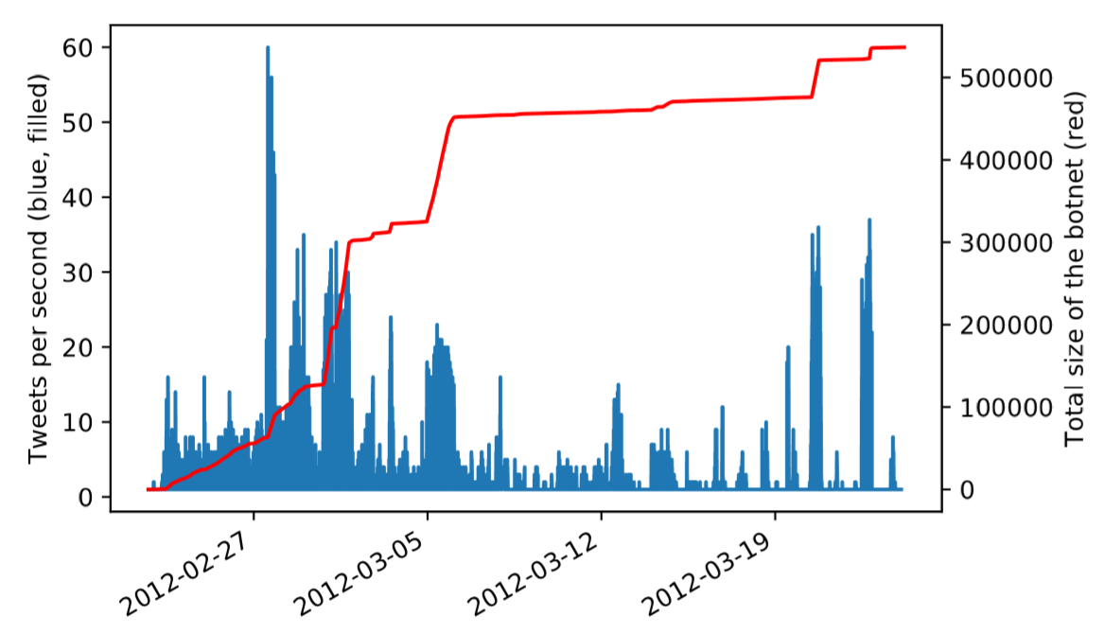
Bursty Botnet Dataset

Slide 20
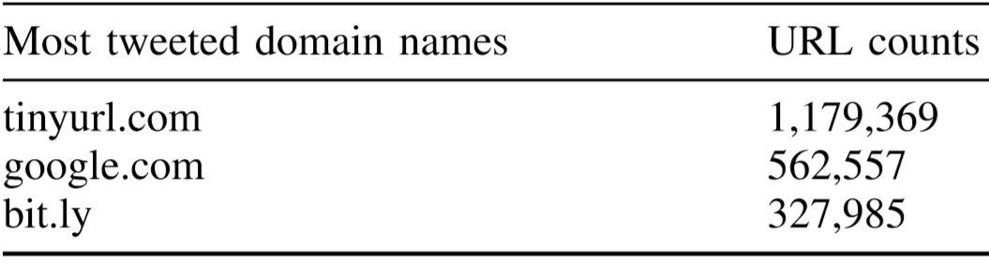
URLs posted and its Analysis
2,823,743 unique URLs used.
Below table for 3 most frequent domain names.

Slide 21
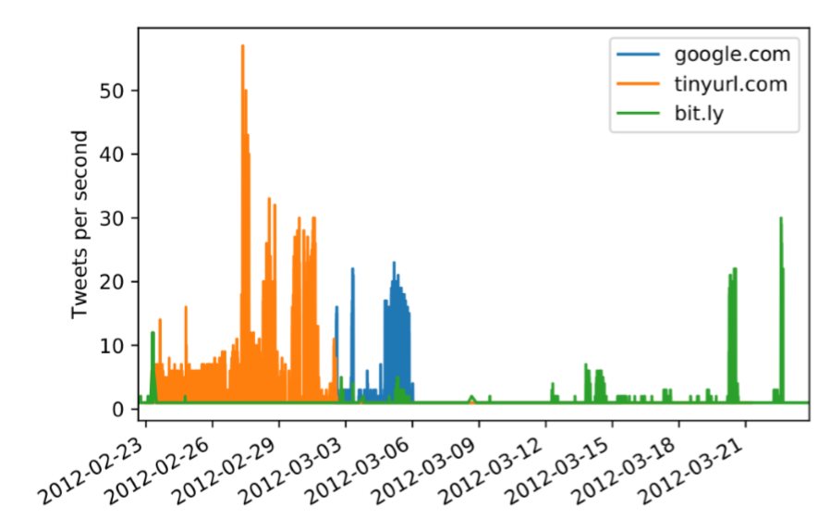
URLs posted and its Analysis
Temporal Clustering is clearly visible.

Slide 22
URLs posted and its Analysis
tinyurl.com links
over 1.1m tinyurl.com links posted by bot.
57% were reported to be spam and stopped.
503,672 directed to facebook-goodies.com
1,937 directed to ggew.info

Slide 23
URLs posted and its Analysis
google.com links
Utilizes open redirect feature of google.
Complex structure of URL
Carefully structured URLs.
561,989 URLs redirects to ggew.info

Slide 24
URLs posted and its Analysis
bit.ly links
330,000 bit.ly URLs.
Provides click status.
5 landing pages.
Top 3 landing pages account for 97% of bots.

Slide 25
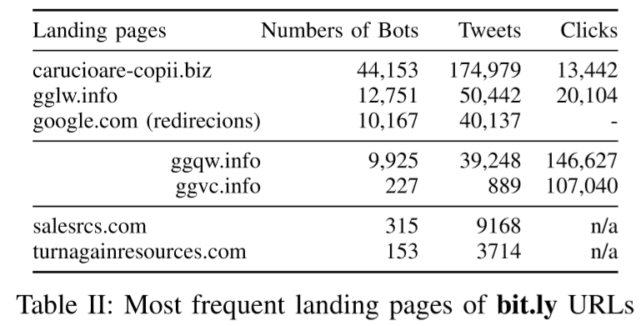
URLs posted and its Analysis

Slide 26
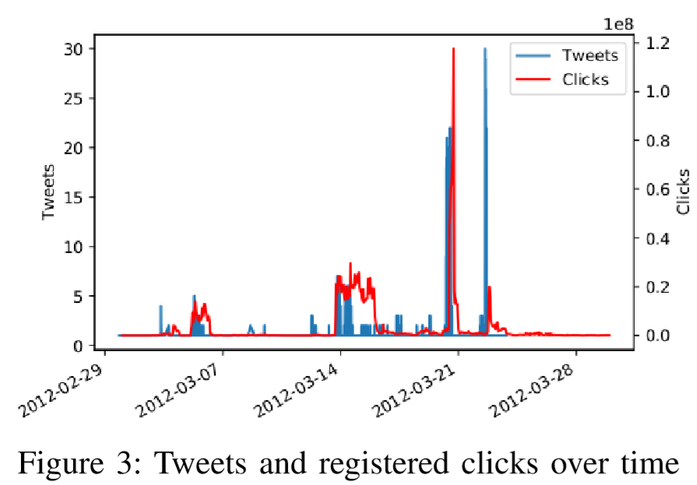
URLs posted and its Analysis

Slide 27
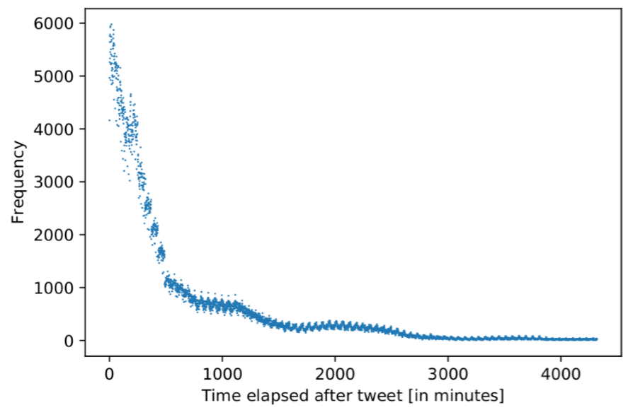
URLs posted and its Analysis

Slide 28
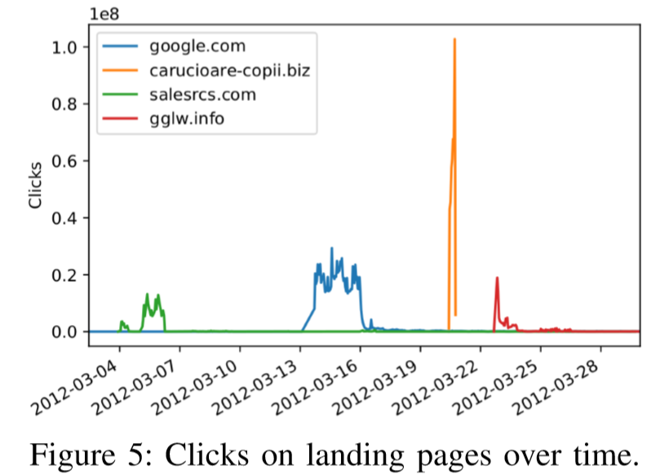
URLs posted and its Analysis

Slide 29
Spam Attack by Bursty Botnet
Tweet Mentions of the Bots
99% of bots mention less than 4 other users.
1,313,008 other users were mentioned
85% were mentioned once.
12% mentioned twice.

Slide 30
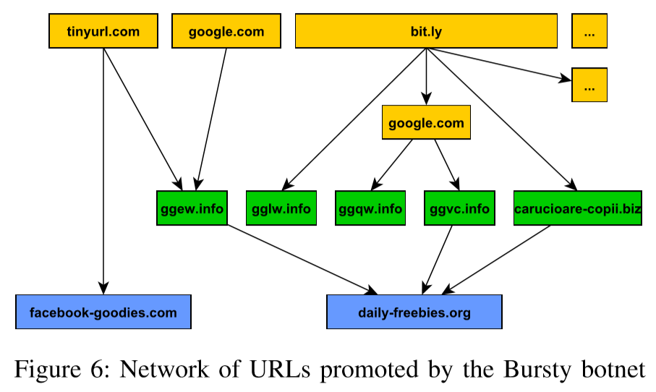
Spam Attack by Bursty Botnet
Network of Spam Attacks

Slide 31
Spam Attack by Bursty Botnet
Botmaster: Alexandru F. (full name is anonymised)
registered over 440 other domains
operates a proxy service
active on ‘blackhatworld.com’
offered an automatic CAPTCHA solving service

Slide 32
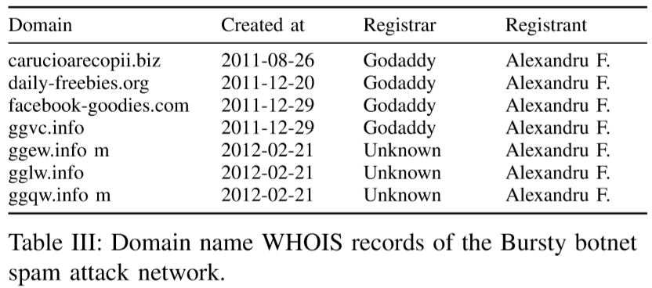
Spam Attack by Bursty Botnet

Slide 33
Spam Attack by Bursty Botnet
Hit and Run Attack Pattern
Based on the information, reconstruction of the path attacker followed:

Slide 34
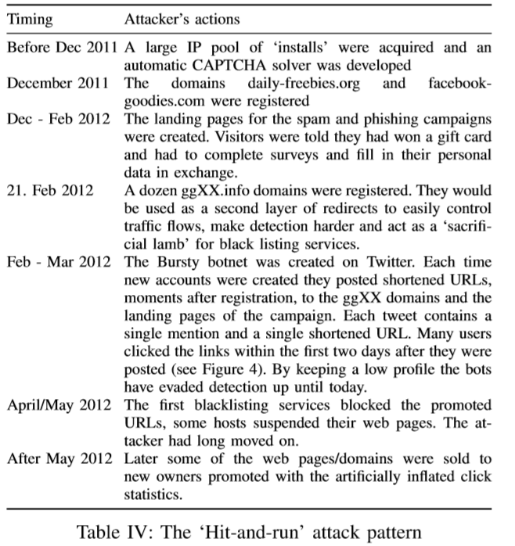

Slide 35
State-of-The-Art Bot Classifiers
‘Botometer’ detection framework
Freely available.
1000 features.
6 categories:
user profile friend
temporal language features
network content

Slide 36
State-of-The-Art Bot Classifiers
Measure detection accuracy of the ‘Botometer’
Experiment: random samples of 1000 accounts from
1) Bursty Botnet
2) random user dataset

Slide 37
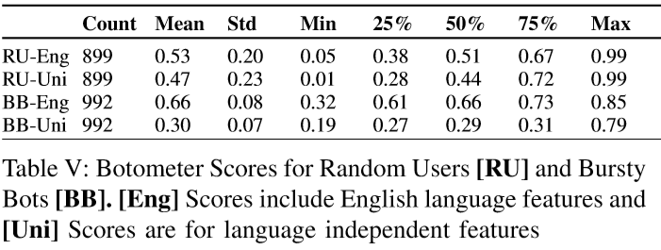
State-of-The-Art Bot Classifiers
Measure detection accuracy of the ‘Botometer’
Results:

Slide 38
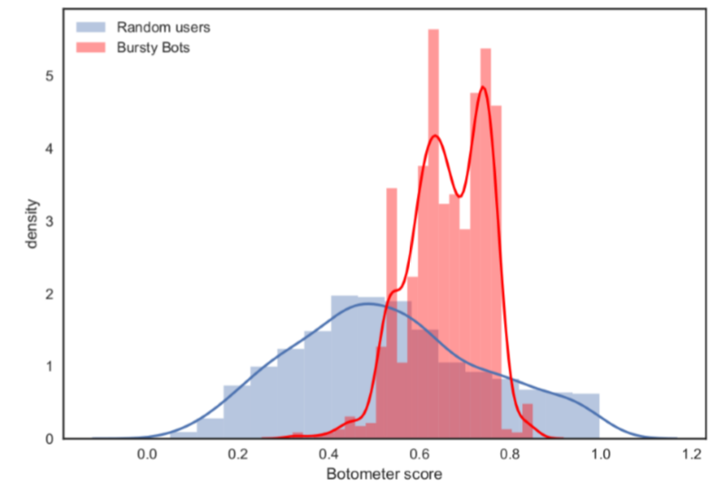
State-of-The-Art Bot Classifiers
Unsupervised Clustering of Accounts
difficult to distinguish between random users and Bursty bots.
low AUC value.

Slide 39
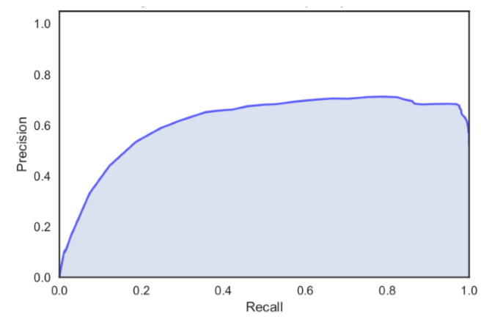
State-of-The-Art Bot Classifiers
Unsupervised Clustering of Accounts

Slide 40
Conclusion
Bursty Botnet one of the largest Twitter botnets reported.
One significant feature of bots: mention very few users and mention very few times using large numbers of bots
Existing blacklists are too slow to protect the majority of users from the “hit-and-run” attack pattern.
Current classifiers cannot detect botnet effectively.
Future Work
Analysis on targets of bot links.
New features for bot detecting
Increase sensitivity of blacklists.

Slide 41
References
Besel, christoph, juan echeverria, and shi zhou. “Full cycle analysis of a large-scale botnet attack on twitter.” In 2018 IEEE/ACM international conference on advances in social networks analysis and mining (ASONAM), pp. 170-177. Ieee, 2018.
E. Ferrara, O. Varol, C. Davis, F. Menczer, and A. Flammini, “the rise of social bots,” communications of the ACM, vol. 59, no. 7, pp. 96-104, 2016.
wikipedia.org

Slide 42




